Slide 1
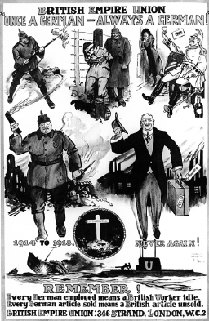
Write down 5 things you notice
What does this source tell us about the attitude to Germany in 1919?

Slide 2
A Vision in Paris:
The Conferences
The Treaties
& The Big Three

Slide 3
What YOU NEED TO KNOW:
Who were the Big Three?
What did they want?
What was the Paris Peace Conference?
What were the outcomes of the Treaty of Versailles?
What were the other treaties?
What was the League of Nations?

Slide 4
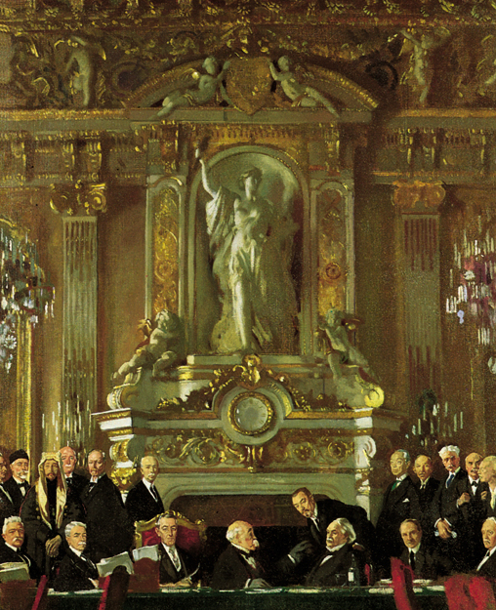
The big three
The “Big Three” included:
US President Woodrow Wilson
French President George Clemenceau
British Prime Minister David Lloyd George
Note: Another individual that was important but obviously not part of the Big Three was the PM of Italy: Vittorio Orlando

Slide 5
Woodrow Wilson
US President
14 points
USA joined the war in 1917
Tried to be fair to Germany

Slide 6
Georges Clemenceau
French President
Nickname: ‘The Tiger’ (aka Le Tigre)
Wanted to destroy Germany
Make sure Germany never threatened France again

Slide 7
David Lloyd George
Britain’s PM
Saw need to punish Germany
Wanted to rebuild trade as well

Slide 8
What the Big Three wanted – USA under Wilson
The USA had only declared war on Germany in 1917 and it had suffered no damage whatsoever.
Wilson arrived in Europe with the “Fourteen Points,” which he hoped would prevent wars in the future.

Slide 9
USA under Wilson (continued)
The most important of these were:
The peoples of Europe should be allowed their own future; he called this “self-determination” and wanted an end to empires that European countries had built up. He was not prepared to allow Italy to take the Adriatic coast.

Slide 10
USA under Wilson (continued)
A League of Nations should be set up to settle disputes between countries in the future.
Many politicians, especially senators who must approve (ratify) in the US opposed the League of Nations because they feared it would tell the US what to do or where to fight. This leads them to oppose treaty.

Slide 11
What the Big Three wanted – France under Clemenceau
Clemenceau wanted Germany to pay for all the damages France had suffered during the four years of fighting.
France had been attacked by Germany twice in the past century.
He also wanted to make sure a war like this would never happen again.

Slide 12
France under Clemenceau (Continued)
He had three main demands:
1) Germany must return Alsace-Lorraine to France; this had been taken by Germany in 1871.
2) Germany must pay Reparations to France to cover the cost of rebuilding the parts of France that had been destroyed during the war (750,00 houses and 23,00 factories).

Slide 13
France under Clemenceau (Continued)
He had three main demands:
3) France should be allowed to take possession of the Rhineland (the near the River Rhine); this was to stop Germany from attacking France in the future.

Slide 14
What the Big Three wanted – Great Britain under Lloyd George
In Britain most people wanted Germany to be punished: “Make Germany Pay” and “Squeeze them until the pips squeak” were popular slogans, but Lloyd George believed that:
Germany should not be treated too harshly; it would only lead to more trouble in the future – feared would fall into the hands of communist Russia.

Slide 15
What the Big Three wanted – Great Britain under George
Germany should be allowed to recover.
France should not be allowed to take the Rhineland.
Lloyd George was only prepared to make the Rhineland “demilitarized”.

Slide 16
The Paris peace conference (1)
The Paris Peace Conference was the meeting of the Allied victors following the end of WW1.
It was to set the peace terms for Germany and other defeated nations, and to deal with the empires of the defeated powers following the Armistice of 1918.

Slide 17
The Paris peace conference (2)
It took place in Paris in 1919.
More than 30 nations attended (including Canada), but the real decision making was in the hands of Britain, France and the USA.
They met, discussed various options and developed a series of treaties ("Paris Peace Treaties") for the post-war world.

Slide 18
The Paris peace (1)
Russia was absent – why? Allies did not recognize the Bolshevik (Communist) government.
Defeated nations were not given any status at the negotiation, so their fate would be decided for them.

Slide 19
The Paris peace (2)
The task of the peacemakers was to establish political and economic stability.
The US was regarded with great hope by many war-weary Europeans.

Slide 20
The conference (1)
Wilson believed that the war was caused by three factors:
Secret diplomacy.
Dominant nationalities oppressing ethnic minorities.
Autocratic governments ruled by elites.

Slide 21
The conference (2)
Wilson announced his Fourteen Points in January of 1918 – “a new world order.”
However, key decisions of the conference were decided, in secret, by the Big Three.
US interest was to maintain their robust economy and place pressure on Britain and France to repay their war loans.

Slide 22
The treaty of Versailles (1)
The outcomes of the Treaty of Versailles:
Treaty of Brest-Litovsk (between Russia and Germany) becomes null and void.
Germany to retreat behind its 1914 boundaries.
Alsace-Lorraine to be returned to France.

Slide 23
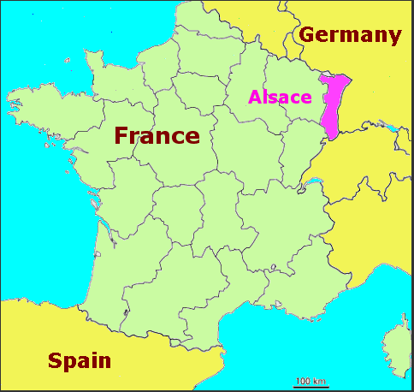

Slide 24
The treaty of Versailles (2)
The outcomes of the Treaty of Versailles continued:
Danzig (Poland) becomes a free city.
Poland gets access to the sea (Polish Corridor) + part of Prussia.

Slide 25
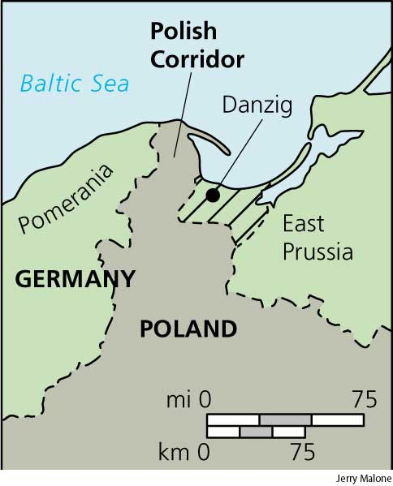

Slide 26
The treaty of Versailles (3)
The outcomes of the Treaty of Versailles continued:
Germany disarmed.
Buffer zones established between France and Germany = occupation of the Rhineland by Allies for 15 years.

Slide 27
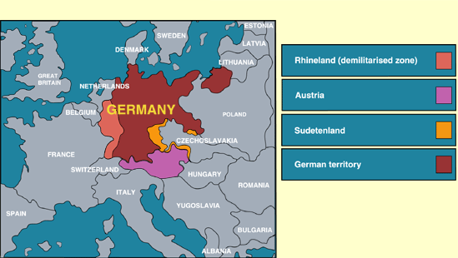

Slide 28
The Paris Peace: Divisions (1)
The Austrian-Hungarian Empire was broken apart:
Austria was reduced to only 12 percent of its prewar size.
Hungary lost 75 percent of its land and became a separate country.

Slide 29
The Paris Peace: Divisions (2)
Czechoslovakia was formed.
Serbia joined with part of Hungary to become Yugoslavia.
The Ottoman Empire was broken apart, setting up a multitude of problems in the Middle East.

Slide 30
Diktat – an imposed settlement
Germany and other defeated nations viewed the Treaty of Versailles as a DIKTAT (an imposed/forced/dictated settlement):
They were not invited to negotiations.
They did not agree to the terms.
They still had the desire to dominate middle Europe (Mittleuropa) and achieve AUTARKY (the quality of being self-sufficient).

Slide 31
Germany’s Objections (1)
The main points the Germans objected to in the Treaty of Versailles were:
The Diktat – treaty dictated not negotiated.
War guilt and repartitions – Germans were forced to accept that WWI was their fault and has to pay exorbitant reparations.

Slide 32
Germany’s Objections (2)
The main points the Germans objected to in the Treaty of Versailles were (continued):
The loss of territory (German land was taken away) – no anschluss (Germany forbidden to unify with Austria).
Disarmament – limits set to the size of the German army and navy and total restrictions on troops in the Rhineland, on the production of tanks, armoured vehicles, aircraft and submarines.

Slide 33
Other countries (1)
The negotiations at the Treaty of Versailles upset more countries than just Germany.
The input of nations outside the Big Three seemed to be ignored.
The countries that had won WWI wanted to make sure that Germany, Austria-Hungary and Turkey could never become so powerful again so the map of Europe was redrawn.

Slide 34
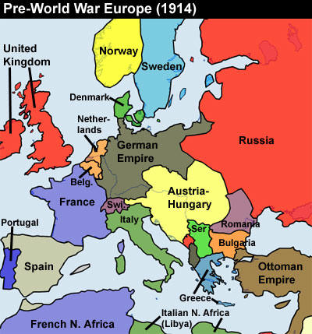

Slide 35
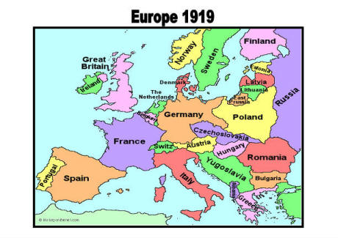

Slide 36
Other countries (2)
Many of the terms of the treaties seemed unfair to the losers, especially to Germans, and they were to cause much trouble in Europe in the next twenty years.

Slide 37
The war guilt clause
Germany was invited for formal signing.
Germany signed treaties and the War Guilt Clause under protest – incensed by the WGC.
The WGC said that Germany accepts responsibility of WWI.
This would cause caused serious repercussions in years to come.

Slide 39
The (other) treaties of Paris: Saint GermainE + Trianon
Versailles was only one of five treaties signed during 1919-1920.
The treaties that dealt with the now split Austria-Hungary included:
The Treaty of Saint Germaine dealt with Austria.
The Treaty of Trianon dealt with Hungary.

Slide 40
The (other) treaties of Paris: Neuilly + Sevres
The treaties that dealt with the defeat of the Central Powers:
The Treaty of Neuilly dealt with Bulgaria.
The Treaty of Sevres dealt with Turkey.
All defeated powers lost territory and agreed to pay some reparations.

Slide 42
links
The Treaty of Versailles + Hitler’s Rise
http://www.youtube.com/watch?v=XoJoj3N-vX4
4:34 minutes

