Slide 1
Turmoil And Tragedy: Steps to War
Aggressive Nationalism in Japan
Spanish Civil War
Appeasement

Slide 2
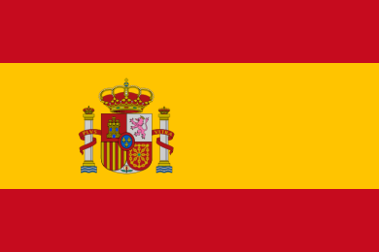
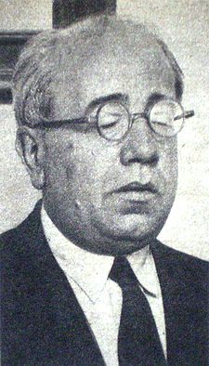
Causes of WWII: The Spanish civil war
Civil War broke out in Spain in 1936.
Began after an attempted coup d'état by a group of Spanish Army generals against the government of the Second Spanish Republic, then under the leadership of president Manuel Azana.

Slide 3
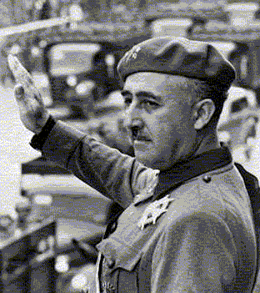
The Spanish civil war
Soon the country was divided into two factions:
Republicans (socialists, communists, left-wing, and anyone else who supported the republic).
Fighting against fascism in defense of democracy.

Slide 4
The Spanish civil war
Nationalists (Catholic Church, landowners and a small fascist party run by Francisco Franco).
Were defending the Christian faith against Communism.

Slide 5
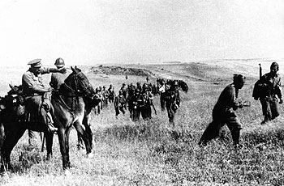
Role of the other Great powers
The role of the other great powers in the Spanish Civil War is important to the background of WWII:
Have fascists helping fascist.
Pits fascism against democracy and communism.

Slide 6
Role of the other Great powers
Many historians refer to the Spanish Civil War as a dress rehearsal for WWII.

Slide 7
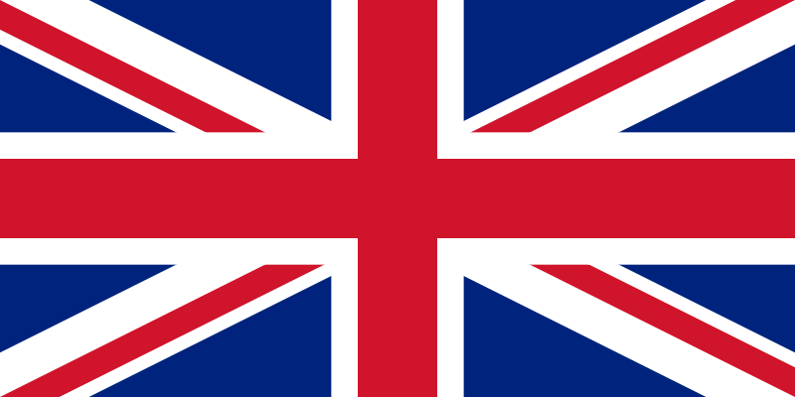
Foreign Intervention: France + Britain
Both officially non-interventionist.
France - socialist leader, Leon Blum feared the fascists in his own country may start a civil war.

Slide 8
Foreign Intervention: Britain + France
Britain still hoped to gain the support of Italy (in a possible anti-German agreement), or at least not to antagonize her.
No desire whatsoever to become involved in another European war.

Slide 9
Britain + France
Politically, Britain and France set up the Non-Intervention Committee of 1936.
Feared that the civil war could spread into an international conflict if they became directly involved.

Slide 10
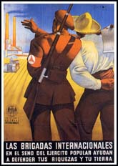
International Brigades
Many of her citizens of Fr. + GB (& Canada) participated on the side of the Republicans though units of volunteers called the International Brigades.

Slide 11
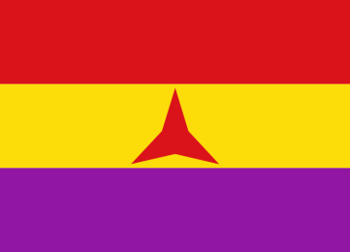
“The First Media War”
Dubbed "the first media war" = several writers and journalists covering it.
The Media wanted their work "to support the cause” and tended to support the Republicans.

Slide 12
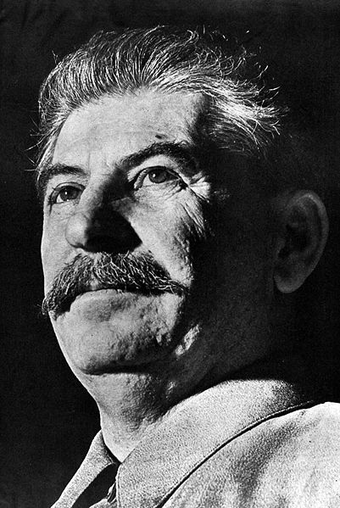
The Soviet Union
The Republicans = military support from the USSR.
Of the non-fascist powers only the Soviet Union sent support to the Republican Government (ironic?!).

Slide 13
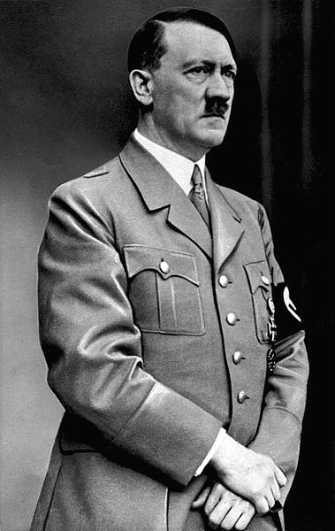
Germany
In October 1936 the Rome-Berlin Axis was signed.
From 1936-38 the Axis Powers poured military support to the Nationalists.
Hitler sent the Luftwaffe.

Slide 14
Germany
To some extent Hitler was experimenting with a new form of warfare.
Use the Spanish experience as a laboratory to test these weapons.

Slide 15
Germany
At Guernica, a city in Northern Spain, a vicious air attack was launched when the Luftwaffe bombed the civilian population.
Combined operations of planes and tanks were often used.
In WWII, such and operation was known as blitzkrieg.

Slide 16
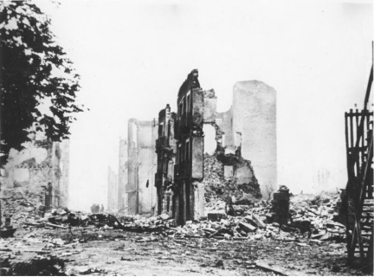
Guernica

Slide 17
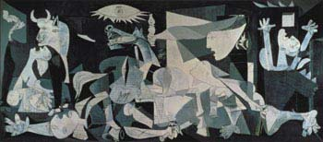
Guernica by Pablo Picasso (1937)

Slide 18
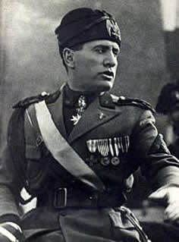
Italy
Mussolini sent 60,000 troops to Spain.
Partly as a result of their mutual involvement in Spain, Italy and Germany came out as the “Axis” powers (this is Mussolini’s term) – not formally allied, yet close friends.

Slide 19
Impact on European Affairs: Hitler
Hitler learned a great deal during the Spanish Civil War:
Democracies, for whatever reasons, were unwilling to forcibly resist right-wing movements in Europe.

Slide 20
Impact on European Affairs: Hitler
If he pushed his luck in some of his pet projects within Europe, Britain and France might well remain non-interventionist = became known as appeasement.

Slide 21
Impact on European Affairs: Stalin
Stalin came to the same conclusions.
Greatly influenced his decision to sign the Nazi-Soviet Pact, August 23,1939, shortly before the war broke out.

Slide 22
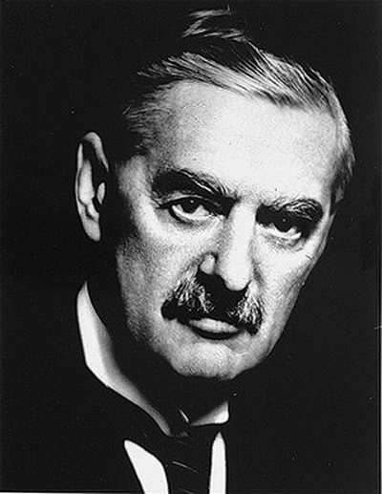
Impact on European Affairs: Britain
In Britain the Labour Party now supported rearmament.
The Conservatives, led by Neville Chamberlain, were busy formulating a policy called appeasement.

Slide 23
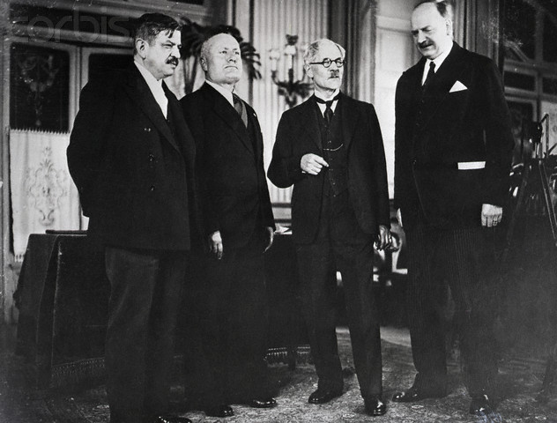
Stresa Front
1935 = Hitler reintroduced conscription in Germany.
Breach of the Treaty of Versailles = France, Britain and Italy together at Stresa in Italy to condemn Hitler’s actions to create the Stresa Front.

Slide 24
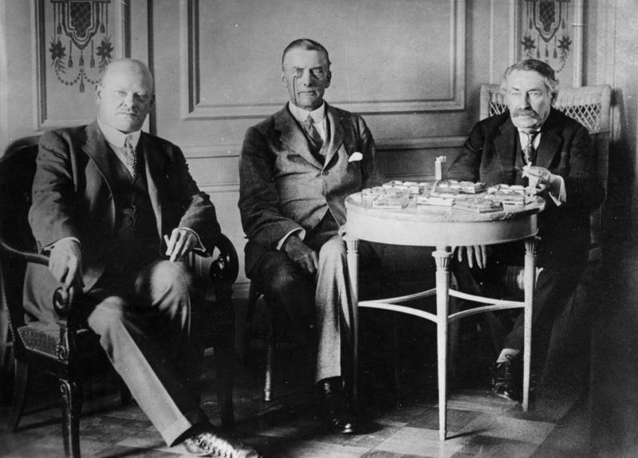
Stresa Front
Stresa Front (1935):
Reaffirmation of the Locarno Treaty (1925, establishment of the Eastern and Western borders of Europe).
Introduced hope for international peace; the “spirit of Locarno.”

Slide 25
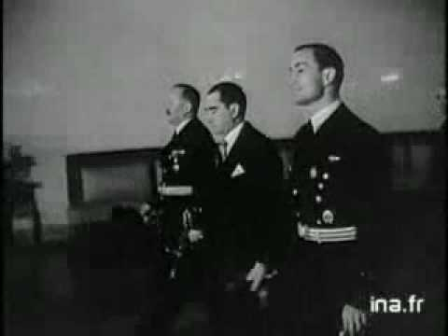
The Franco-soviet treaty of mutual assistance
France signed a Franco-Soviet Treaty of Mutual Assistance, 1935 with the USSR.
To contain Germany’s aggression.

Slide 26
The Stresa Front Aborted
Mussolini lost interest in this arrangement when Britain signed the Anglo-German Naval Agreement (keep their navy’s the same size) with Hitler in June 1935.
The aborted Stresa Front, however, showed that Italy and Germany were not necessarily allies.

Slide 27
Costs of the Spanish Civil War
Spanish Civil War, 1936 - 1939.
An estimated total of 300,000+ people lost their lives.
Out of them probably 120,000+ were civilians executed by either side.

Slide 28
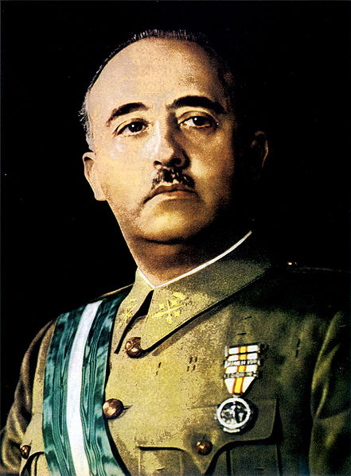
Costs of the Spanish Civil War
The Nationalists under General Franco won the war.
Francisco Franco Bahamonde, commonly known as Francisco Franco or simply Franco, was a military general, and head of state of Spain (dictator) from October 1936 (whole country from 1939 onward – until 1975).

Slide 29
Costs of the Spanish Civil War
Republican authorities arranged the evacuation of children.
These Spanish War Children were shipped to Britain, Belgium, the Soviet Union, other European countries and Mexico.

Slide 30
Costs of the Spanish Civil War
The Nationalist side also arranged evacuations of children, women and elderly from war zones.
Refugee camps for those civilians evacuated by the Nationalists were set up in Portugal, Italy, Germany, the Netherlands and Belgium.

Slide 31
Importance of the War
Excellent background to the immediate causes of WWII:
It strengthened the ties between Mussolini and Hitler.
In 1937, Italy joined the Anti-Comintern Pact with Germany and Japan to oppose international Communism.

Slide 32
Importance of the War
Spain was used as a testing ground for new weapons (planes) of the fascists.
The war made the ideas of war acceptable again because of the International Brigades = certain things were worth fighting for or against.

