Slide 1
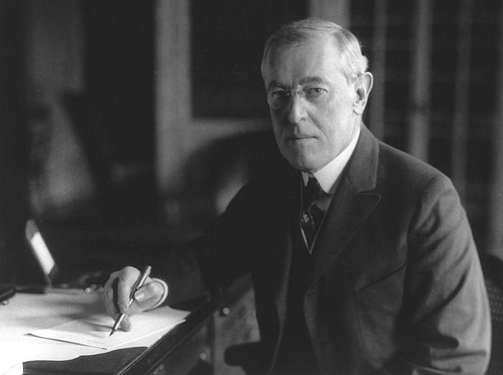

Slide 2
Wilson’s Nationalism
A Stabilizing or Destabilizing Force?

Slide 3
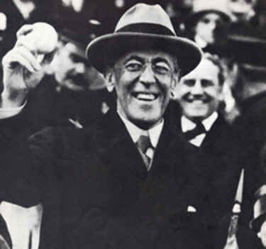
Woodrow Wilson’s Fourteen Points
President Wilson had to justify sending troops to Europe, so he outlined his reasons for entering the war in his Fourteen Points, announced on January 8, 1918.

Slide 4
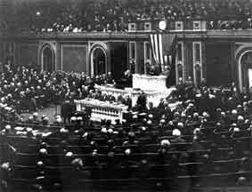

Slide 5
Dealing with Governments
The first five suggested a complete change in the ways governments should be dealt with in the future:
There should be no more secret treaties:
governments should make deals openly with each other.
They should allow freedom of navigation on the high seas.

Slide 6
Dealing with Governments
They should encourage free trade between countries.
They should be reduce their armaments.
When future claims for colonies were made, the interests of other people must be taken into account.

Slide 7
Conquered Lands
The next three outlined German withdraw of conquered lands:
German troops should move out of Russian territory.
German troops should move out of Belgium.
Alsace and Lorraine (Alsace-Lorraine) should be handed back to France.

Slide 8
National Self-Determination
The next five points showed that Wilson sympathized with the principle of national self-determination:
Italy's frontiers should be be restored along clear lines of “nationality.”
The peoples of the Austrian Empire should be given the opportunity of self-government.

Slide 9
National Self-Determination
Serbia, Montenegro and Romania should be restored, and Serbia given access to the sea.
People in the Turkish Empire who were not Turks should be given the opportunity of self-government.
An independent Poland should be created and given access to the sea.

Slide 10
Collective Global Security
The final point emphasized the need to set up a system for collective global security to avoid future world wars and monitor the state of global affairs:
14. An international organization should be set up to protect the independence of all states.

Slide 11
Clear Purpose
Before the U.S. came in, the war aims of the Allied Powers had been vague:
Defeat Germany.
Now the defeat of Germany was given a clear purpose.

Slide 12
Clear Purpose
Wilson also pointed out that greed for territory and power was the cause of the war and he suggested a plan for peace with the intention of making future wars impossible.

Slide 13
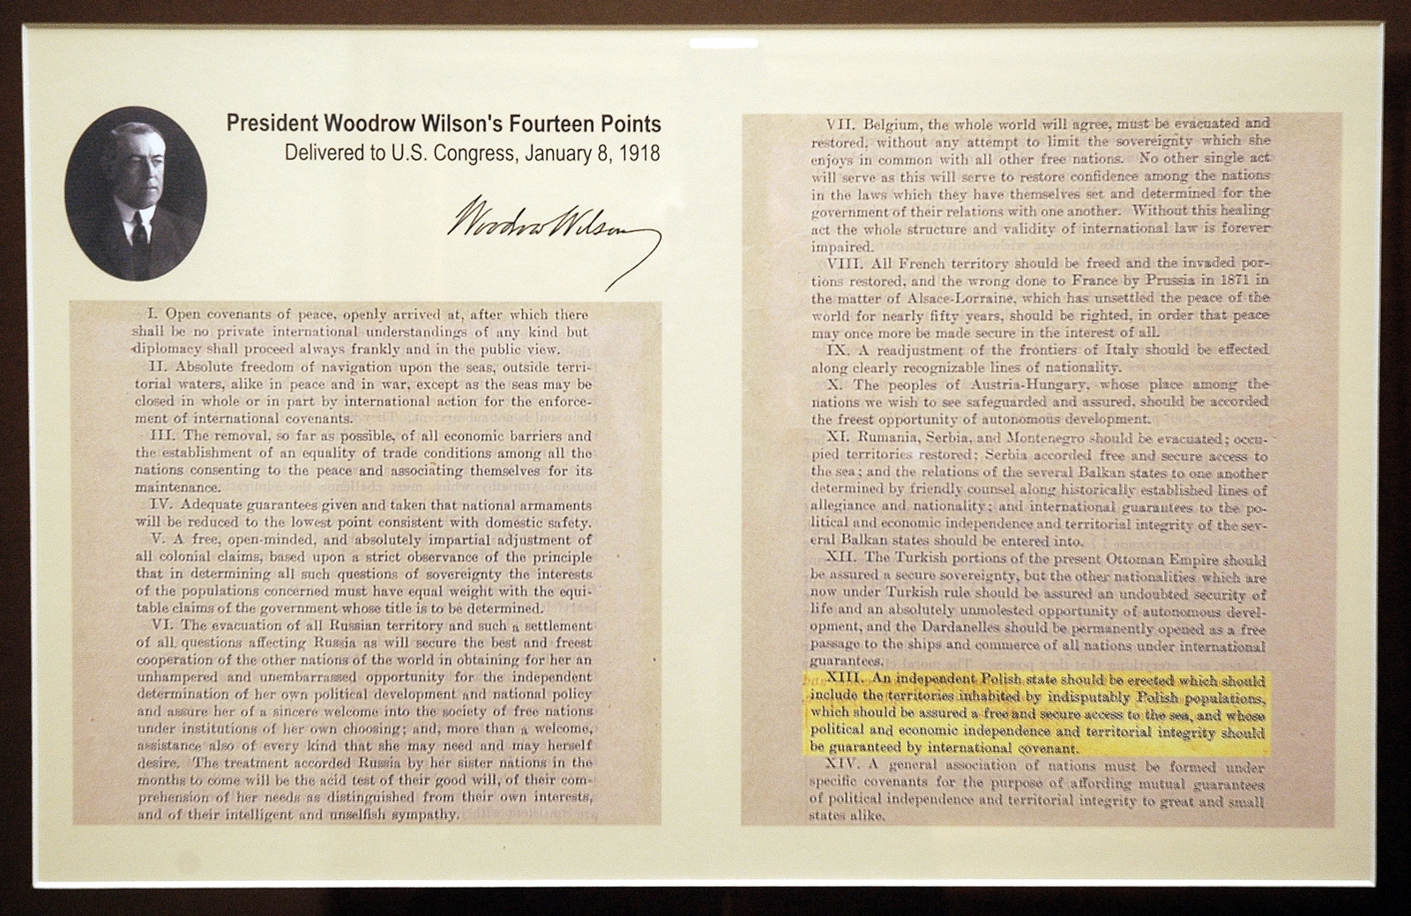

Slide 14
Links
this one is best:
http://www.youtube.com/watch?v=14zM9DBHuhE&NR=1
Paris peace (repeat):
http://www.youtube.com/watch?v=ShRA8HRMR4Q
WWI review:
http://www.youtube.com/watch?v=Tzin0L3yNzk&feature=related
Others
http://www.youtube.com/watch?v=Ouw3OdcL5GI
http://www.youtube.com/watch?v=J31vkB4IdS0&feature=related

