Slide 1
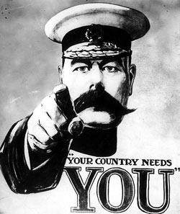
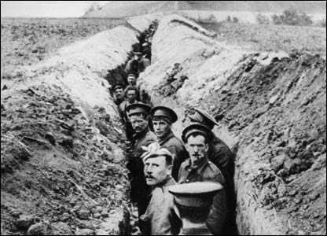
http://www.youtube.com/watch?v=ToQTmUl_6XA

Slide 2
WAR
The days of peace and slumberous calm are dead.
~ John Keats

Slide 3
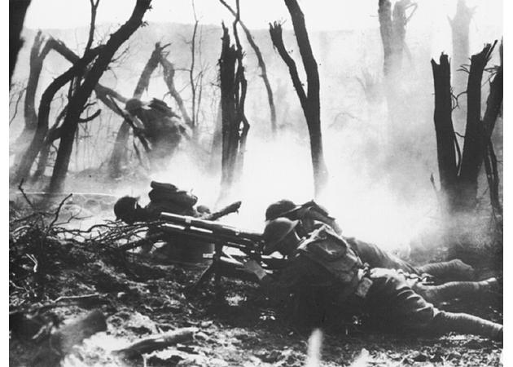
The War to End All Wars: World War I

Slide 4
Questions to Ponder: Part I
What is Nationalism?
What are the important qualities of a nation’s culture?
What is Imperialism?
Western European countries colonized what two countries in the second half of the 19th Century?
Why did Western European countries and the USA desire to create colonies?

Slide 5
Questions to Ponder: Part II
What is the significance of nationalism and imperialism in the world of 1919?
Why did some countries emerge from the 1900s as powerful nations while other parts of the world were unable to keep up?
How did industrialization and modernization pave the way for global conflict?
What were the main causes of WWI?

Slide 6
Definitions: Part One
Nationalism
A patriotic loyalty among the people within a state resulting from common bonds of language, culture and tradition.
Irrational gut feelings.

Slide 7
Definitions: Part Two
Militarism
The belief or desire of a government or people that a country should maintain a strong military capability and be prepared to use it aggressively to defend or promote national interests.

Slide 8
Definitions: Part Three
Imperialism
The act of one country acquiring dominance of another country or region.
Basically, industrial nations taking advantage economically and militarily over weaker ones.

Slide 9
Definitions: Part Four
Colonialism
Is the building and maintaining of the colonies in one territory by people from another territory.
Colonialism is a process whereby power over the colony is claimed by the mother country and social structure, government and economics within the territory of the colony are changed by the colonists.

Slide 10
Definitions: Part Four
Colonialism (continued)
Colonialism is a certain set of unequal relationships, between mother country and colony and between colonists and the indigenous population.

Slide 11
Events Leading up to WWI
Industrialization led to the development of Great Powers:
Great Britain
France
Germany
USA
Japan

Slide 12
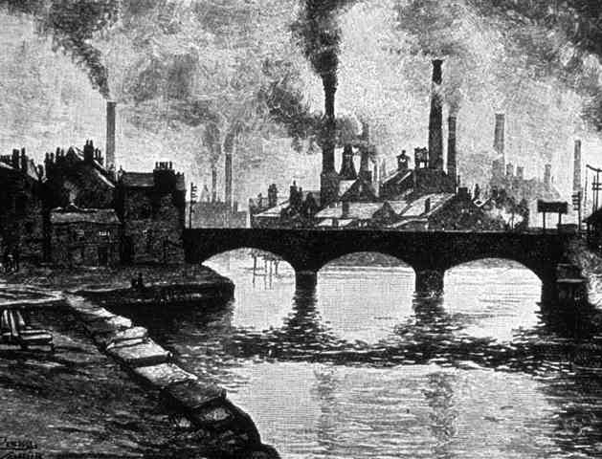
Industrialization
Those that could industrialize had:
An increased standard of living
Military power
Economic growth
The ability to wage sustained, mechanized war

Slide 13
Industrialization
In order to maintain progression of industrialization, nations needed resources/colonies.
This created competition and led to international tensions.

Slide 14
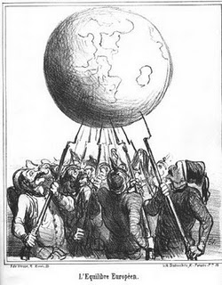
Realpolitik
By 1900, nearly all the world had come under the domination of the industrial powers.
Realpolitik – an expansionist national policy having as its sole principle interest advancement of the national interest.
There existed a rivalry for GLOBAL DOMINANCE – each nations wanted to be “the most powerful.”

Slide 15
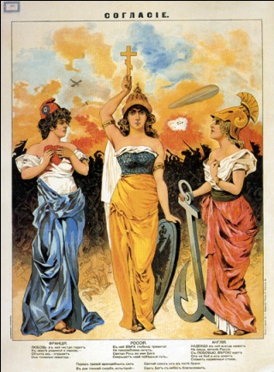
System of Alliances
By 1914, Europe was split into two hostile alliance systems:
The Triple Entente (Allied Powers):
France, Russia (would drop out and be replaced by the USA), and Britain.
The Triple Alliance (Central Powers):
Germany, Austria-Hungary, and Italy (would drop out and be replaced by the Ottoman Empire).

Slide 16
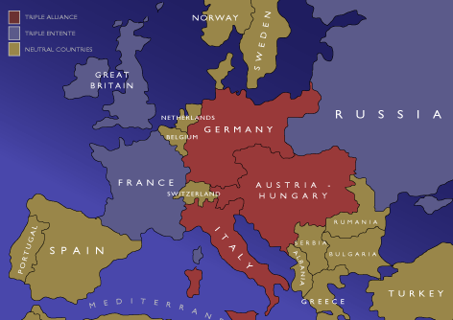

Slide 17
Governance Reminders: Allies
FRANCE = Democratic Government ruled by Raymond Poincaré as President of France and Georges Clemenceau as Prime Minister of France
RUSSIA = Nicholas II was Czar of Russia, King of Poland, and Grand Duke of Finland.

Slide 18
Governance Reminders: Allies
BRITAIN = Monarchy/Democratic with George V as King of the United Kingdom and David Lloyd George as Prime Minister of the United Kingdom.
USA = Democracy led by Woodrow Wilson the President of the United States.

Slide 19
Governance Reminders: Central
GERMANY = Monarchy with a Kaiser (King) at the helm of government = Kaiser Wilhelm II.
AUSTRIA-HUNGARY = Dual Monarchy ruled by and Emperor of Austria who was also the King of Hungary = King Francis Joseph I.

Slide 20
Governance Reminders: Central
ITALY = was a Kingdom/Monarchy ruled by King Victor Emmanuel II.
OTTOMAN EMPIRE = was an Imperial Government ruled by King Enver Pasha.

Slide 21
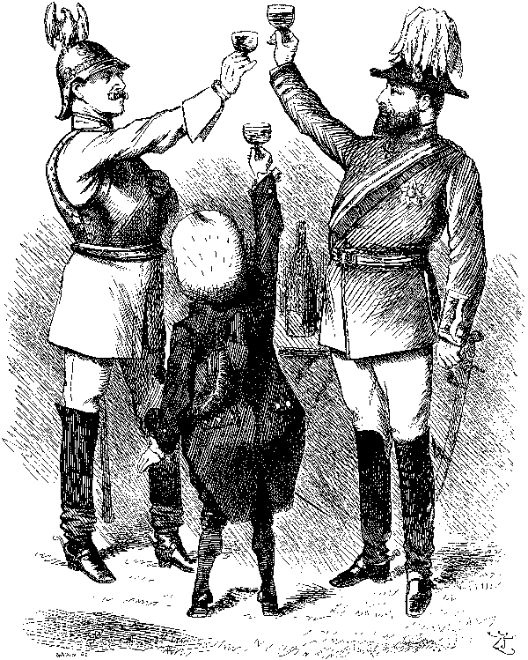
Two Hostile Camps – The Dangers
Such a situation contains inherent dangers = counting on the support of its allies, a country might pursue a more reckless course.
Furthermore, a conflict between two states might spark a chain reaction/domino effect that draws in the other countries, transforming a limited war into a general war.

Slide 22
On the Brink of Chaos
The costly arms race and the maintenance of large standing armies by all states except Britain served to increase fear and suspicion between the alliances.
Countries in Europe had become war machines linked to one another through a web of diplomatic alliances - the chaos just needed to be set in order.

Slide 25
The Drift toward War: The Balkan Wars
The Balkan Wars (1912-1913) upset the balance of power in Europe.
The European alliances (Triple Entente/Triple Alliance) shifted from mutual defense to preparing for war.

Slide 26
The Drift toward War: The Balkan Wars
France and Britain began initial expansion followed by Britain.
This alarmed Germany (who already had a strong military force) – developed the Schlieffen Plan.

Slide 27
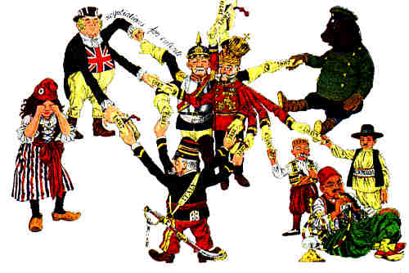
“The Powder Keg of Europe”
The Balkan Wars also strained relations between Austria-Hungary (wanted control over Serbs) and Serbia (revolutionaries wanted independence).

Slide 28
“The Powder Keg of Europe”
The Balkan Wars left the region unstable, inviting revolution and power intervention.
The Balkans were known as “The Powder Keg of Europe.”

Slide 29
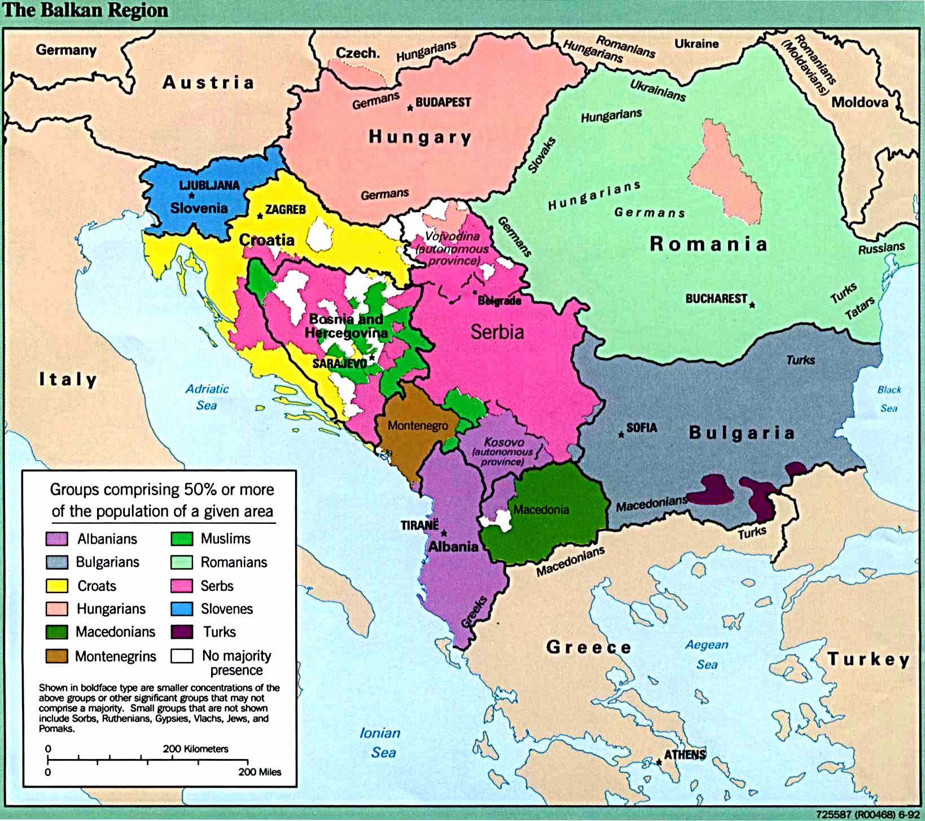

Slide 30
“The shot heard around the world” – The spark of WWI
On June 28, 1914, Archduke Francis Ferdinand, heir to the throne of Austria-Hungary, was assassinated while making a state visit to Sarajevo, the capital of Bosnia.
Gavrilo Princip, a young revolutionary assassin from Bosnia, was linked to the Serbian army/The Black Hand.

Slide 31
“The shot heard around the world” – The spark of WWI
Austria-Hungary decided to use the assassination as a pretext (excuse) to crush/take over Serbia/invade and squash revolutionists.

Slide 32
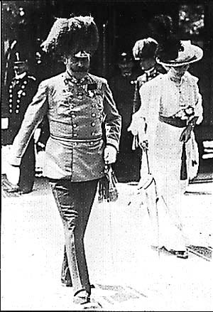
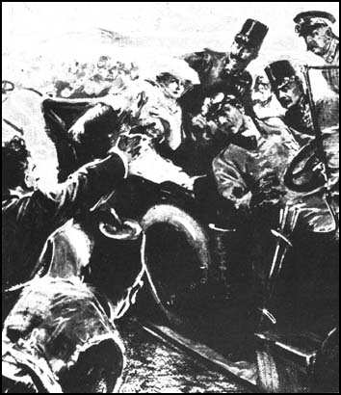
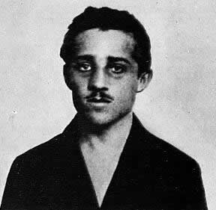

Slide 33
Pre-existing Alliances come into Play
Seeking a military solution rather than a diplomatic one, Austria presented a list of ultimatums to Serbia that it could not possibly meet.
When Serbia could not agree to all of the demands, Austria-Hungary mobilized its army.

Slide 34
Pre-existing Alliances come into Play
If Austria-Hungary invades Serbia, Russia agreed it would intervene on Serbia’s behalf (both had large Slav populations).
If Russia interferes with the invasion Germany asserted it would get involved.

Slide 35
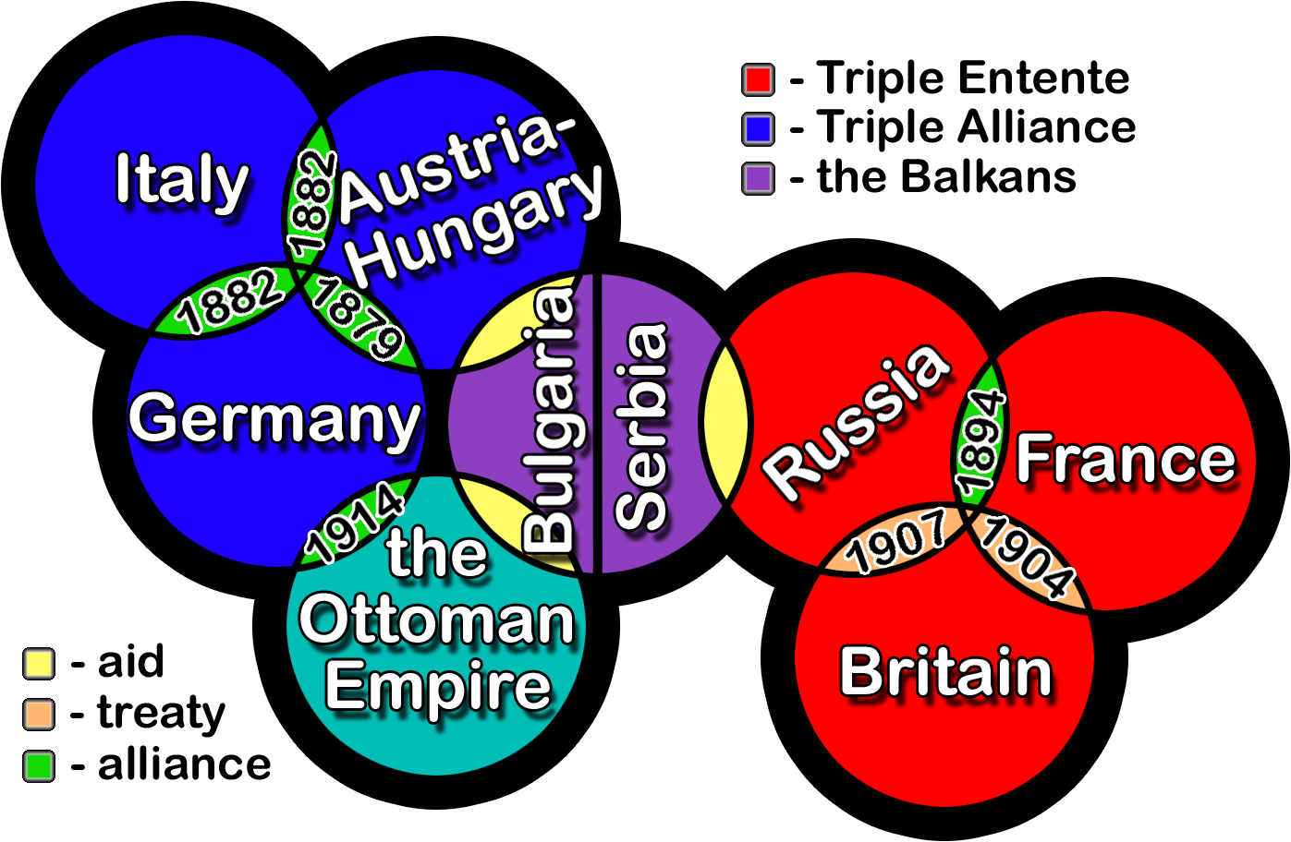
Back in the Day: WWI Causes Animation
http://www.youtube.com/watch?v=htyue8xRS7M&feature=grec_index

Slide 36
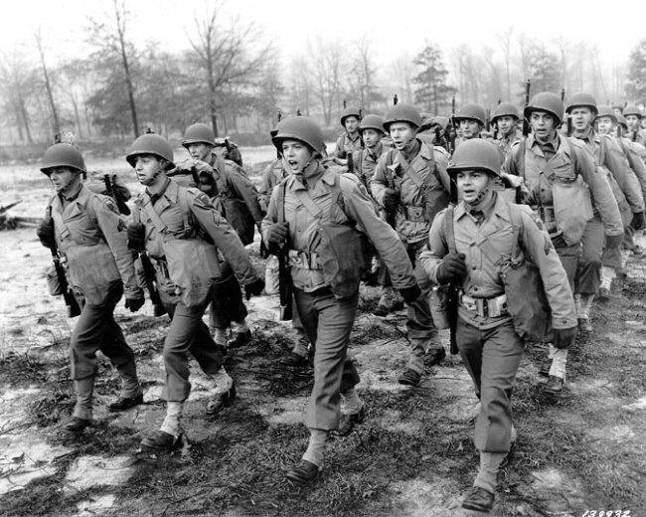
Moves Towards War
Germany urges Austria–Hungary on to war.
Believes there will be a quick victory before Russia and France mobilize.
Germany pledged to support Austria, via a “Blank Cheque” to unconditionally support A-H and their actions against Serbia, believing that a war with Russia was inevitable.

Slide 37
Moves Towards War
Italy did not, thus breaking the Triple Alliance.
Russia mobilized in response to Austria-Hungary’s demands on Serbia (protect fellow Slaves).

Slide 38
A Show of Arms
On July 28, 1914, Austria declared war on Serbia.
Germany delivers an ultimatum to Russia to stop mobilization and demands that France declare neutrality and give up its important territory.

Slide 39
A Show of Arms
Russia, with the assurance of French support, began to mobilize its army.
“The German Question” (What would Germany do?) was about to be answered with a show of arms.

Slide 41
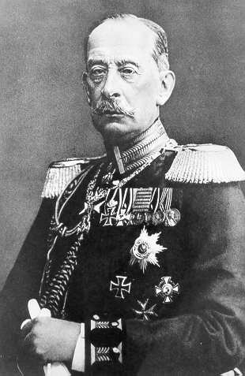
The Schlieffen Plan
German plan to avoid a war on two fronts:
Russia in the East (The Eastern Front)
France in the West (The Western Front)
The plan was to attack/defeat France first and knock them out of the war, then concentrate on Russia in the East

Slide 42
The Plan (in action)
Smash France in 30 days before Russia could respond with troops.
Go through neutral Belgium to surround French troops, defeat the French and then rush to Poland front on the German rail system to face Russia.
Once Russia began to mobilize, Germany had to attack France.

Slide 43
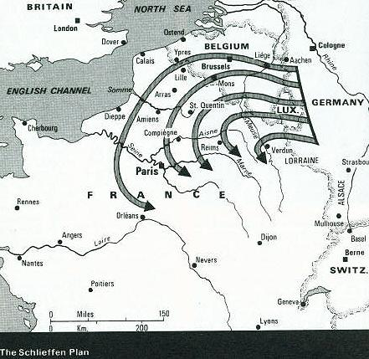

Slide 44
Why it did not work (1)
With the invasion of Belgium, Britain responded because of long-standing agreement to protect Belgium and sent over 100,000 well-trained men.
This delayed Germany’s advance on the Western Front, enabling the French to bring in further reinforcements.

Slide 45
Why it did not work (2)
The Western Front became a static war, with troops in trenches (trench warfare) for the remainder of WWI.
In addition, Russian armies mobilized faster than expected.

Slide 46
Why it did not work (3)
Germany now was in a war on two fronts.
Question:
How does this (a war on two fronts) make it more difficult for Germany to come out victorious?

Slide 48
The World goes to War - World War I Begins
Russia wanted to stop 15 days into the 30 day time table but Germany did not want to risk it.
On August 1, 1914, Germany declared war on Russia and implemented the Schlieffen Plan.
The invasion of Belgium (August 4, 1914) by Germany brought Great Britain into the war.

Slide 49
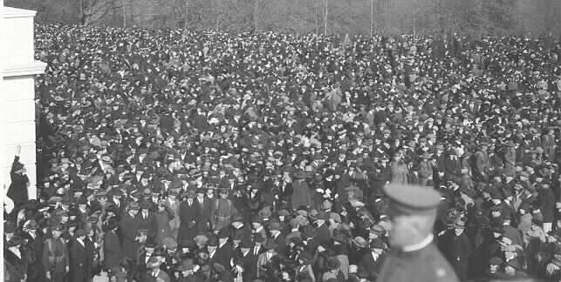
War as Celebration
News of war was greeted by most Europeans with great enthusiasm and with outpourings of patriotism and nationalism.
People greeted WWI with enthusiasm because:
War was romanticized.
It was about adventure, heroes and medals.
What death and defeat???

Slide 50
A Short War
In addition, everyone believed that it would be a short war.
6 weeks – over by Christmas.
There were no recent wars that reminded people that wars take a long time.

Slide 51
Adventure and National Glory
For decades, state-directed education had indoctrinated youth with nationalist attitudes, beliefs, and myths designed to promote social cohesion.
Thus, Europe marched off to war with great joy, anticipating a great adventure and national glory.

Slide 53
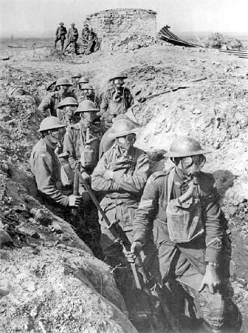
Stalemate (1)
The war quickly became a stalemate.
Trench warfare led to this stalemate = Defense was as strong or stronger than offense (military tactics had not kept up with military technology).
New military technology (machine guns, aerial bombing, poison gas, flame throwers, land mines, armored tanks).

Slide 54
Stalemate (2)
European armies had prepared only for offensive warfare.
Throughout the war we would see armies go “over the top” out of the trenches in an offensive.
The result was mass carnage with very little advancement.

Slide 55
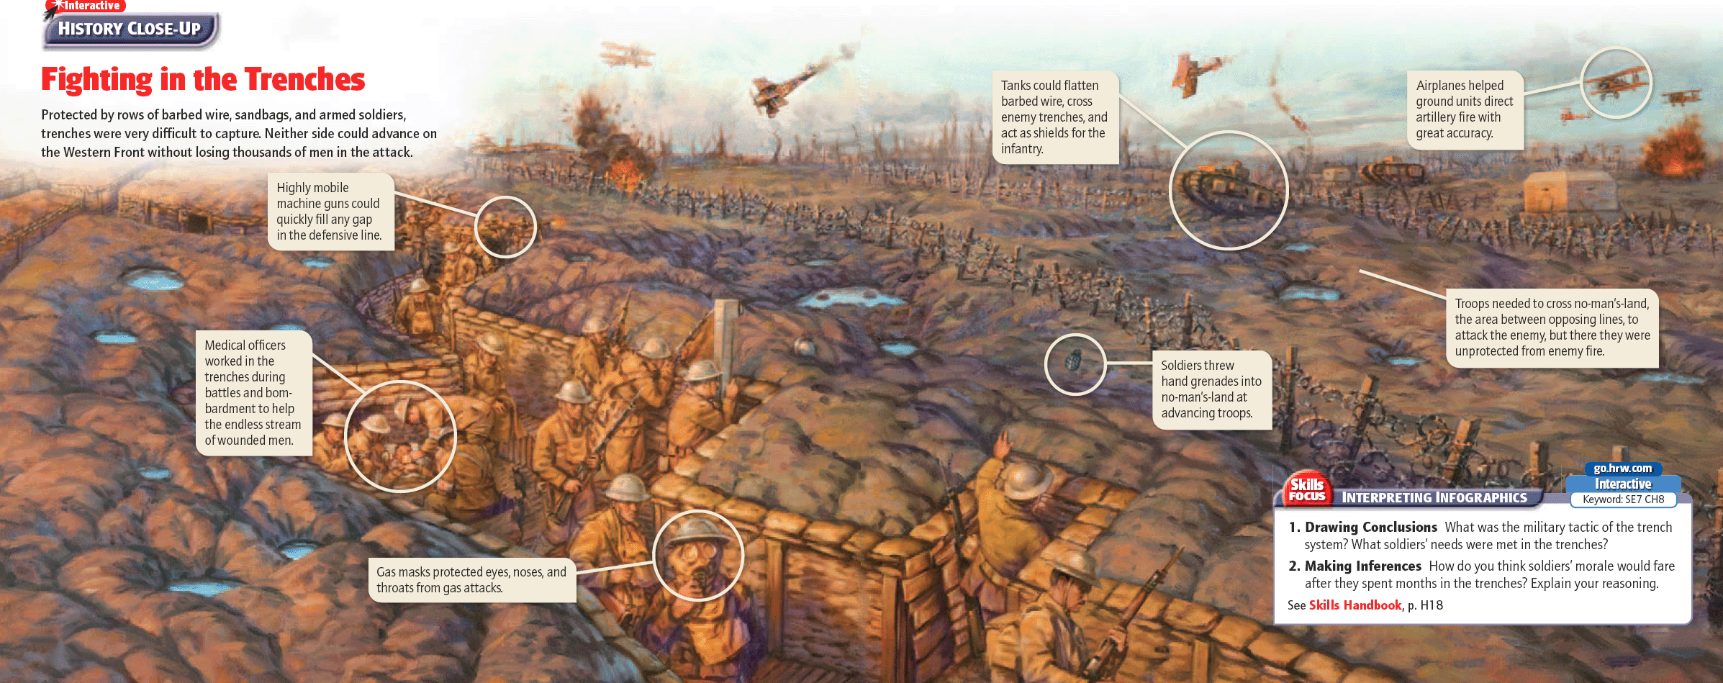

Slide 57
A Static War
The Germans could not quickly secure victory over the French.
This was due to the fact that the Russian army mobilized faster than anticipated and the Germans had to divert troops to the Eastern Front.

Slide 58
A Static War
The Germans had great success against the Russians.
Yet, the resources needed to fight on the Eastern Front ensured that the stalemate on the Western front would continue.
The result was a deadlock that neither side could break.

Slide 60
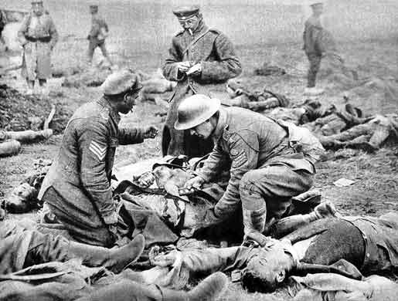
Empires at War
The horrors of war finally reached across the continents.
The sprawling Ottoman Empire battled British and Russian-led forces in Egypt, Iraq, and the Caucasus.
In East Asia, Japan declared war on Germany and seized German possessions in China.

Slide 61
Colonial Conscription
The British and French conscripted colonial subjects:
India: 1 million soldiers to Allies (60,000 died).
Africa: more than 1 million soldiers, 3 million transported goods (150,000 died).
Australia, New Zealand, and Canada: Over 1 million.

Slide 62
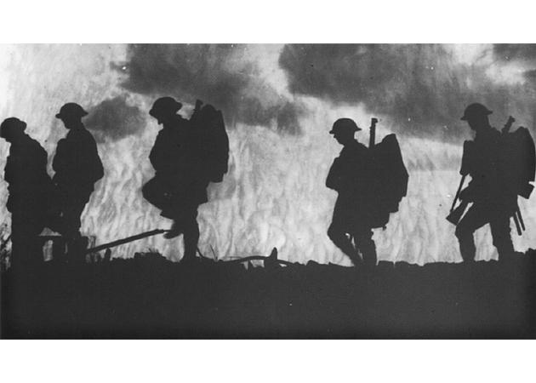
U.S.A. Involvement
USA declares war on Germany on April 6, 1917 = The USA joined WWI for many reasons:
Unrestricted submarine warfare (RMS Lusitania = British Ocean liner sunk by German U-boats), Zimmerman Telegram, British propaganda, the Russian Revolutions.

Slide 63
U.S.A. Involvement
The Zimmerman Telegram was a main reason the USA entered the war.
Telegram was intercepted and decoded.
Stated German support for Mexican claims to Arizona, Texas and New Mexico.
Meant to be a diversion for the USA to keep them out of the war.

Slide 64
USA vs. Germany
With America’s entry, the war was transformed (at least according to President Woodrow Wilson) into a moral crusade: an ideological conflict between democracy and autocracy (government where one person possesses unlimited power).
Wilson had been able to claim WWI as a moral crusade because of the revolutions in Russia (rise of communism).

Slide 65
USA vs. Germany
USA entry into the war guaranteed victory over Germany:
Germany was tired from the war.
Could not compete with the USA military might after four years of battle.

Slide 66
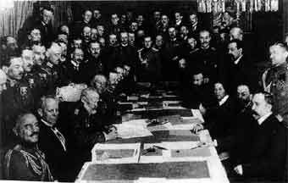
The Treaty of Brest-Litovsk
The Treaty of Brest-Litovsk was signed on March 3, 1918 between Germany and Russia.
Russia was unable to sustain fighting because of the Russian Revolution.

Slide 67
The Treaty of Brest-Litovsk
This treaty allowed Russia to pull out of the war, but at a huge cost to Russia:
Payment to Germany of 6 billion marks.
Surrender to all western non-Russian territories of the empire.
Russia lost large population/major resources/factories.

Slide 68
War of Attrition
With Russia out of the war, the Germans prepared for a decisive offensive before the U.S. could land sufficient troops in France to help the Allies.

Slide 69
War of Attrition
A war of attrition (grinding down/a decrease in numbers) now favored the Allies, who could count on American supplies and manpower.
Without an immediate and decisive victory, Germany could not win the war.

Slide 70
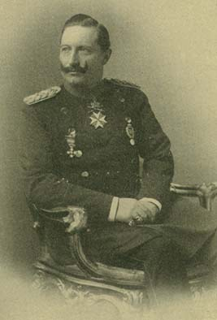
Armistice, Abdication & Democracy
The offensive failed.
Fearing an Allied invasion of Germany, Kaiser Wilhelm II abdicated and fled to Holland.
A new German Republic is organized:
The DEMOCRATIC Weimar Republic.

Slide 71
Armistice: November 11, 1918
Armistice was signed on November 11, 1918, ending the hostilities.

Slide 72
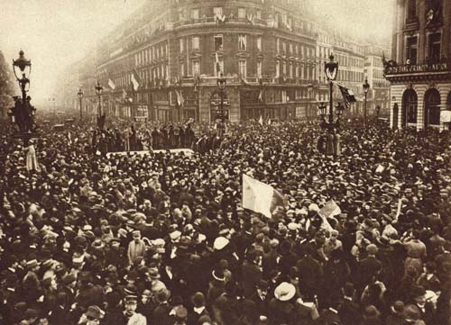

Slide 73
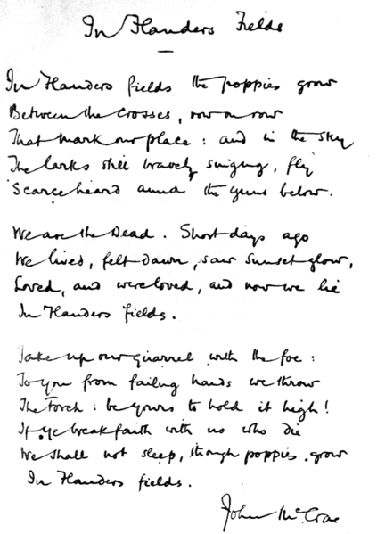

Slide 74
The Impact of World War I
Political
The war led to the overthrow of monarchies in Russia, Austria-Hungary, Germany, and Turkey.
It contributed to the rise of the Bolsheviks to power in Russia in 1917.
It fanned the flames of revolts against colonialism in the Middle East and Southeast Asia.
Economic
WWI devastated European economies, giving the U.S. the economic lead.
The U.S. still faced problems such as inflation, which left people struggling to afford ordinary items.
Farmers, whose goods were less in demand than during the war, were hit hard.
Social
The war killed 14 million people and left 7 million men disabled.
The war drew more than a million women into the U.S. workforce, which helped them pass the Nineteenth Amendment to get the vote.
It also encouraged African Americans to move to northern cities for factory work.

Slide 75
Cost of the War: Human
The war is likened to a mass extermination of a generation of youth.
15 million people were killed:
About 1/3 of the soldiers that fought in the war were wounded.
1 in 3 were disabled.

Slide 76
Cost of the War: Economic
The economic cost was severe:
Estimates put the damage at about 100 trillion modern U.S. dollars.
The European economy was left in shambles and the U.S. emerged as the dominant world economic power.

Slide 77
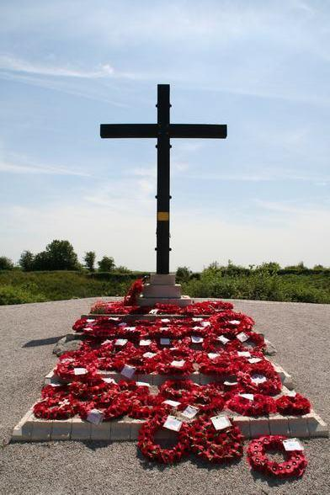

Slide 78
The Spanish Flu (Influenza)1918
The Spanish Influenza first struck in the trenches of the western front and then flourished when soldiers returned home in1918.
It became the greatest public health disaster of modern history.

Slide 79
The Pandemic Killed
The pandemic killed between 22 and 30 million people worldwide, or roughly twice as many as had died during the fighting.
In Spain, it killed roughly 40 percent of the population (8 million), thus giving it the name of the Spanish Influenza.

Slide 80
Unsurpassed Death
British colonial troops carried it to India where it killed 12 million.
No disease, plague, war, famine, or natural catastrophe in world history had killed so many people in such a short time.

Slide 81
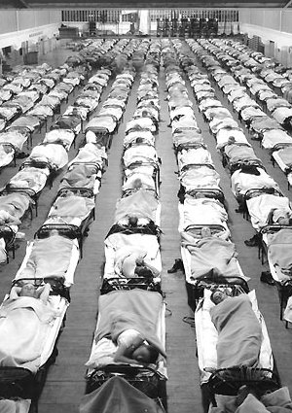

Slide 83
WWI: Some Films Etc.
All Quiet on the Western Front (1930/1979)
Lawrence of Arabia (1962)
Von Richthofen and Brown (1971)
In Love and War (1996)
The Trench (1999)
A Very Long Engagement (2004)
Gallipoli (1981/2005)
Passchendaele (2008)
The Red Baron (biopic; 2008)
Beneath Hill 60 (2010)

