Slide 1
Turmoil And Tragedy: Steps to War
Aggressive Nationalism in Japan
Spanish Civil War
Germany + Appeasement

Slide 2
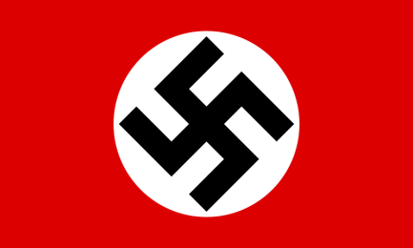
Causes of WWII in Europe: Nazi Germany
The causes of WWII in Europe began in 1919 (Treaty of Versailles, Failure of Collective Security) and during the Great Depression.
However, there were more immediate causes.

Slide 3
Causes of WWII in Europe: Nazi Germany
Nazi Foreign Policy before the outbreak of the war was based on four general principles:
1. The Repudiation of the Treaty of Versailles
Cancel reparations
Rearmament
Conscription
Reoccupation of Rhineland

Slide 4
Nazi Germany
2. Uniting all German people with the Fatherland
German people in Austria, Sudetenland of Czechoslovakia, Western Poland/Polish Corridor, East Prussia.

Slide 5
Nazi Germany
3. Lebensraum
“Living space” in the East (especially Ukraine) for Germany’s superior races.
4. Rearmament of Germany
Prepare for war.

Slide 6
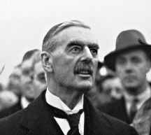
The Nazis + Appeasement
Appeasement:
An approach to foreign relations that attempts to maintain peace by making concessions to the aggressor so as to prevent the aggressor from going to war.
France and Britain.

Slide 7
Appeasement
Key ideas of appeasement:
People are peace-loving.
Drastic peaceful revision of the status quo.
Hope (then eventually fear).

Slide 8
Reasons for appeasement
GB = revisionist school of thought since they signing of the Versailles Treaty.
Do anything to avoid a repeat performance of WWI.

Slide 9
Reasons
British standpoint = a strengthened Germany was good for Europe for trade purposes and for offsetting Russian and/or French influence.
The appeasers saw Hitler as a block against communism – they hated communism more than fascism.
The Balance of Power concept was not dead.

Slide 10
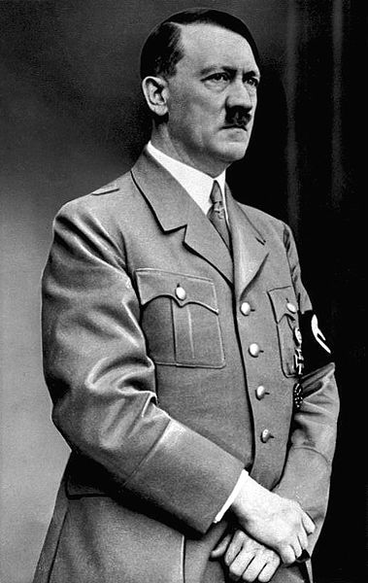
An Unstoppable aggressor
None of the items on Hitler’s “Hit List” (his aims) were vital British interests.
Weaknesses = an aggressor, knowing he will be appeased, will, step by step, change the status quo until the new status quo is such that he will no longer be stopped by concessions.

Slide 11
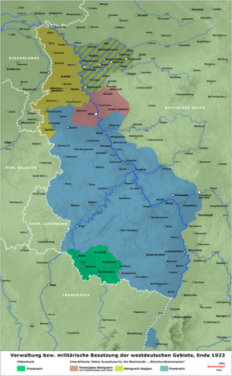
The Rhineland crisis
What happened?
Hitler’s army occupied the demilitarized Rhineland.
March 7, 1936.

Slide 12
The Rhineland crisis
Hitler’s Excuse:
Franco-Soviet Pact.
Reoccupation = defensive measure against France.

Slide 13
A Convincing offer
How did Hitler get away with it?
Timing was good (Abyssinian Crisis occurring).
Offered twenty-five years of peace and a demilitarized zone on either side of the Rhine.
Offered to rejoin the LON.

Slide 14
Ultimatums: The Austrian Crisis
February 1936 = Hitler and Kurt von Schuschnigg (Chancellor of the First Austrian Republic) met at Berlin and Hitler gave him an ultimatum:
Take the pressure off the Austrian Nazi Party.
Make Arthur Seyss-Inquart, leader of the Austrian Nazis, the Minister of the Interior.

Slide 15
The Austrian Crisis
Schuschnigg had no base for resistance against Hitler so he was forced to agree.
Schuschnigg resigned, was replaced by Inquart, and Hitler was free to operate.

Slide 16
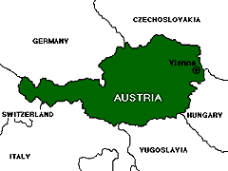
Annexation: the anschluss of Austria
Goering then sent Inquart the telegram that he in turn was supposed to sent to Germany “requesting the German government to dispatch German troops as soon as possible to restore law and order.”
On March 12, 1938, German troops invaded Austria without opposition.

Slide 17
the anschluss of Austria
On March 13, 1938 = law that abolished Austrian sovereignty and made Austria an integral part of Germany.
On April 10, 1938 a “plebiscite” was held = “99.75%” of Austrians “approved” of this annexation (the incorporation of territory into another geo-political entity)

Slide 18
Appeaser’s Reactions
GB had no interest in Austria.
France had no intention of acting without the British.

Slide 19
Reactions
Hitler’s concern over invading Austria had not been GB and Fr, but Italy.
Mussolini, no longer an equal to Hitler, gave his approval.

Slide 20
Summary + significance

Slide 21
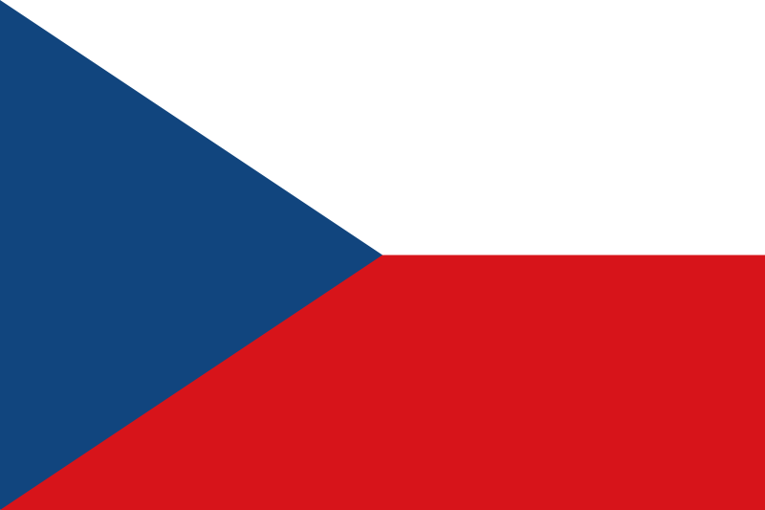
The Czechoslovakian crisis
Hitler’s next target would be Czechoslovakia.
His interests lay in the Sudetenland.
This region was the far west boundary of Czechoslovakia and held approximately 3.5 million ethnic Germans.

Slide 22
The Czechoslovakian crisis
The Sudetens became excited after Austria.
Injustice the Germans living under foreign “domination.”
Real goal = dismemberment of the Czechoslovakian state.

Slide 23
A Crisis in two stages
The Czechoslovakia Crisis comes in two stages:
In the first stage (October 1938, also known as the Munich Crisis) appeasement was working the way it was designed by Chamberlain and others.

Slide 24
A Crisis in two stages
It is in the second stage (March 1939) that it becomes all too clear that the policy of appeasement had been an outright disaster.

Slide 25
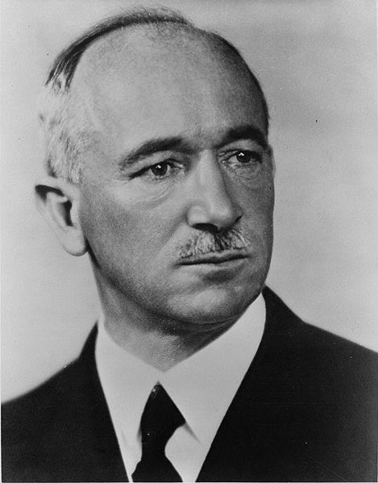
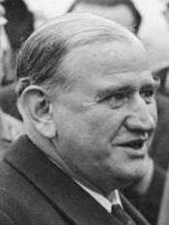
Prelude to The Munich Crisis
Edvard Benes (PM of Czechoslovakia) = saw Hitler for what he really was – an aggressor.
Neville Chamberlain and Édouard Daladier (French PM) would pester Benes to give up the Sudetenland.

Slide 26
The Munich Crisis
Early September 1938, Benes made a surprise move = offered Sudetens virtually everything they had been demanding.
Both the Sudetens and Hitler were caught off guard.

Slide 27
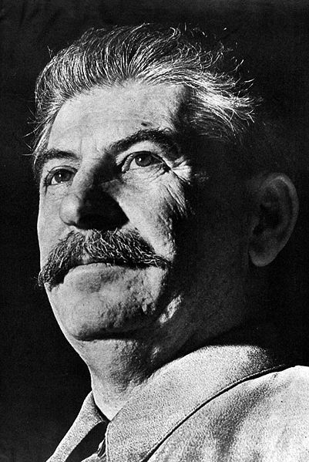
responses
Czech – Benes was determined to resist and hoped his alliances with France, USSR, Rumania (Romania) and Yugoslavia would deter Hitler.
USSR – Stalin clearly supported the Czechs and would help if the French did.

Slide 28
responses
France – Daladier thought of alliances in the terms of getting help, not giving it. Also was convinced British help was necessary.
Britain – Chamberlain sought a compromise via self-determination and being unprepared for war.

Slide 29
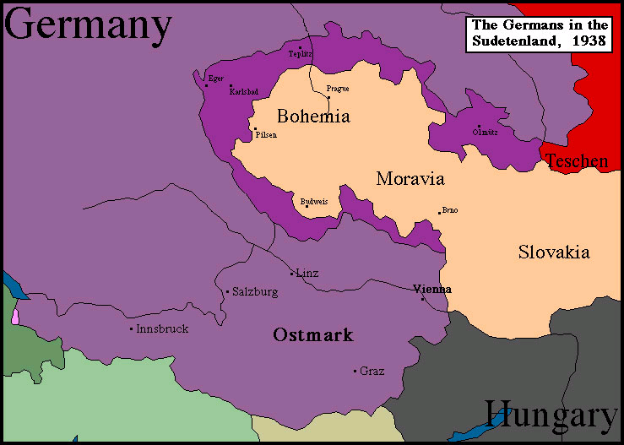
Classic Appeasement
On September 15, 1938 Chamberlain rushed to meet Hitler at Berchtesgaden to discuss the matter.
The outcome = classic appeasement:
Germany could take over the Sudetenland.

Slide 30
Threat of the Occupation of Sudetenland
By September 20th, 1938 Benes had been convinced to accept.
Hitler announced on October 1, 1938 that he would occupy the Sudetenland.

Slide 31
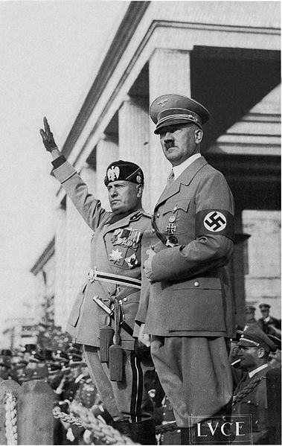
The Munich Conference/Pact
Mussolini proposed a Four Power Conference at Munich (Germany, Italy, France + Britain).
The Munich Conference (September 29, 1938) = Hitler gave Mussolini the terms he wanted and would accept.

Slide 32
The Munich Conference + Munich Agreement/ Pact
The major “concession” = delay the occupation until October 10.
At the Conference, Britain and France (not Czechoslovakia) agreed to the German occupation of the Sudetenland (on the principle of self-determination).

Slide 33
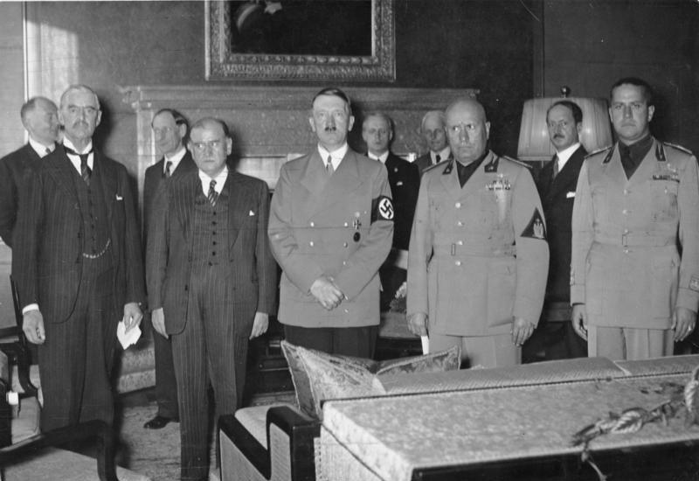
Chamberlain, Daladier, Hitler and Mussolini at the Munich Conference

Slide 34
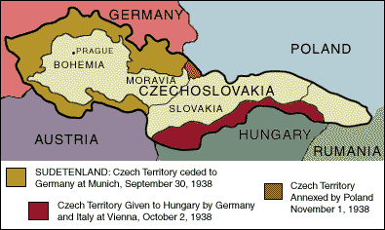

Slide 35
Waving a “Piece of paper” The “Peace for Our time” Speech

Slide 36
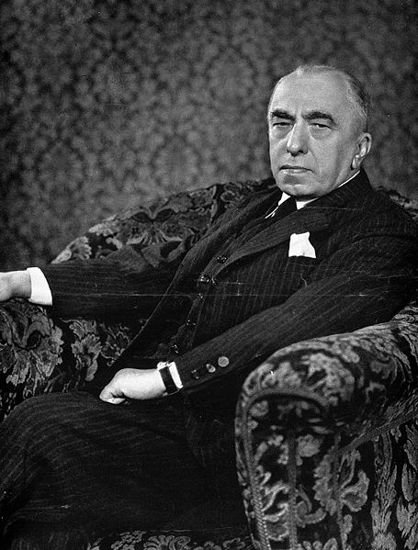
Czechoslovakia: The Apex of Appeasement
When Chamberlain announced, “We have peace for our time.”
Hitler took Czechoslovakia in March 1939.
Benes resigned = replaced by Emil Hacha.

Slide 37
The Apex of Appeasement
The take-over of Czechoslovakia was about Hitler’s intent to dominate/control of Europe.

Slide 38
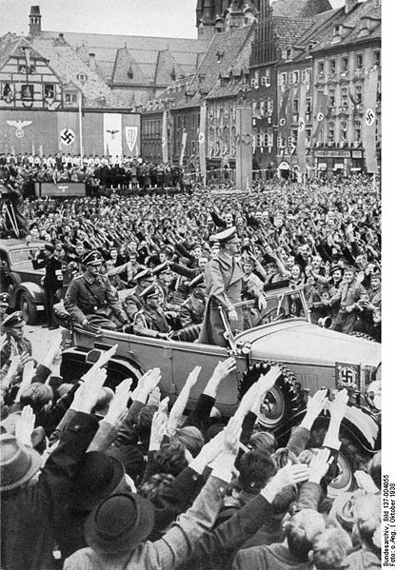
Hitler enters Sudetenland

Slide 39
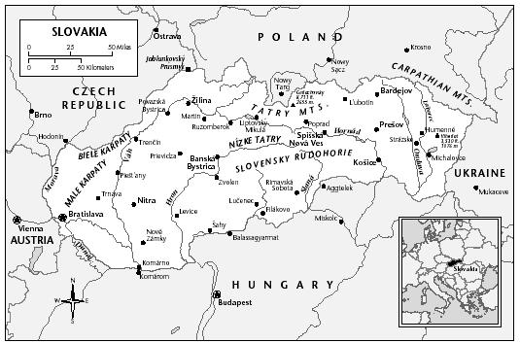
The Slovak state
February 1939 the Slovak state grew turbulent.
Puppet fascist state which existed from 14 March 1939 to 8 May 1945 as an ally and client state of Nazi Germany and was divided up by Hungary and Poland.
Present-day Slovakia.

Slide 41
The Slovak state
March 9, 1939 the Czechoslovakian government dismissed the local Slovak government.
The Czechoslovakian troops prepared to move in.
Hitler continued to recognize the independence of the Slovak state.

Slide 42
The end of Czechoslovakia
March 13, 1939 Hitler’s troops moved into Moravia and Bohemia to “aid” the Slovaks.
Today part of the Czech Republic.
Hacha went to see Hitler = sign away Czechoslovakian independence or face invasion.

Slide 43
The end of Czechoslovakia
On March 15, 1939 Czechoslovakia became a German protectorate.
A protectorate is a territory that is protected diplomatically or militarily against third parties by a stronger state or entity.

Slide 44
Summary + significance

Slide 45
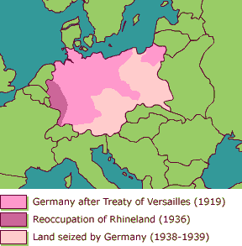

Slide 46
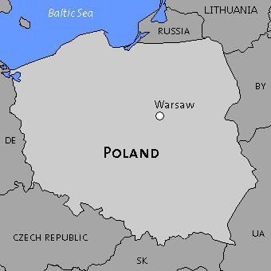
War over Poland: expanding guarantees
On April 13, 1939 –French and British gave Romania and Bulgaria a guarantee that they would back them up.
Fr. And GB also gave total support to Poland in case of invasion.

Slide 47
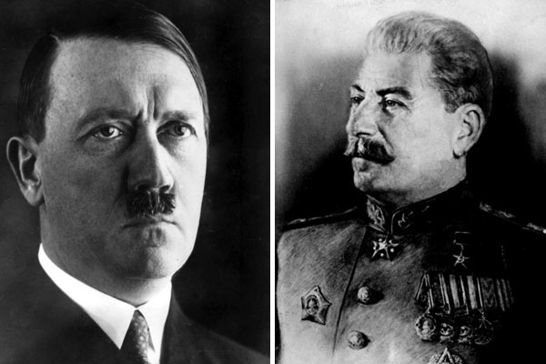
Stalin approaches the West
The Soviets were suspicious of the West ability (inability) and willingness (unwillingness) to stop Hitler.
British and French had missed their last chance to exercise collective security against Hitler when they failed to sign an agreement with the USSR.

Slide 48
Stalin rejected
They rejected Stalin’s advances for a anti-Hitler pact because:
Suspicious of Stalin’s motives.
Unsure of the Red Army after Stalin’s purges.
Could not persuade the Poles to allow Russian troops to cross Poland should there be a war with Hitler.

Slide 49
Stalin makes a deal with the devil
The Russo-German or Nazi-Soviet Non-Aggression Pact of 1939 war signed on August 23 between Hitler and Stalin.
Agreed:
Not to fight each other.
To carve up Poland in half.
Both gained time and security.

Slide 50
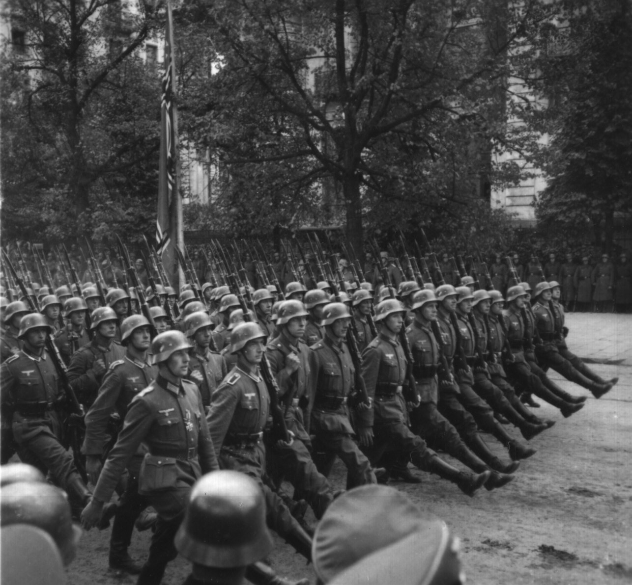
Beginning the Invasion of Poland
Agreement guaranteed a war with Hitler = not have to worry about an Eastern Front.
In the last weeks of August Hitler tried to persuade GB and Fr. that his claims on the Polish Corridor and Danzig were legitimate.

Slide 51
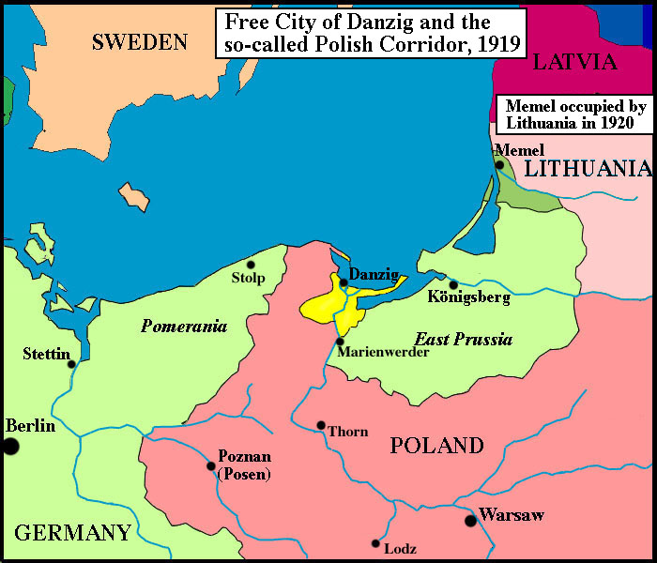

Slide 52
Invasion & WWII
On Sept 1, 1939 Hitler invaded Poland, and the Russians did the same from the other direction.
Hitler sent a blitzkrieg against Poland and WWII began.

