Slide 1
Turmoil And Tragedy: Steps to War
Aggressive Nationalism in Japan
Spanish Civil War
Appeasement

Slide 2
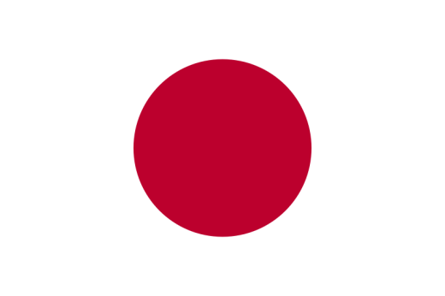
Causes in The Pacific: Japanese aggression
By the 1920s Japan the most powerful industrial country in Asia.
After WW I, a concerted effort towards democracy was hindered by the military.
The Military had established firm control by 1930.

Slide 3
Japan in depression: First attempt to break out
Japan was devastated by the Great Depression.
Japan’s first attempt to break out of the Depression was in the form of Keynesian economics.
The Finance Minister, Korekiyo Takahashi, practiced a policy of big spending to bring Japan out of the Depression.

Slide 4
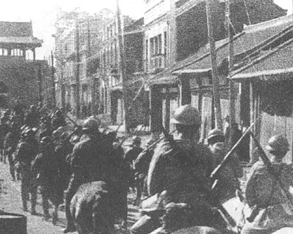
Japan in depression: second attempt to break out
Japan needed living space, raw materials and markets.
Japan’s second attempt to break out of the Depression was to go on a war of conquest venture: The Manchurian Crisis/Mukden Incident, 1931.

Slide 5
The empire of the sun
After the Manchurian Crisis the civilian government lost complete control of the military.
The military wanted to be imperialistic, so they took over several Northern provinces of China to be buffer zones against the USSR.

Slide 6
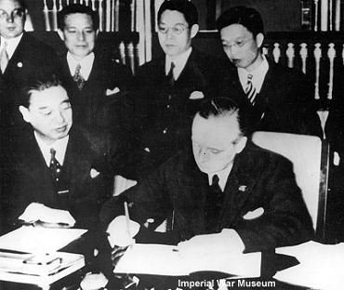
The “New Order”
Three policies of the Japanese Military:
Take over the islands of the Pacific Ocean for raw materials.
Strengthen Manchuria to protect against the USSR.
Take over China by controlling the river systems.

Slide 7
The “New Order”
Japan signed the Anti-Comintern Pact with Nazi Germany in 1936 and invaded the main part of China (1937).
They declared a “New Order” = promised a government for the common people, but in fact, was simply the occupation of a foreign land.

Slide 8
Non-involvement
Britain was still scared of war.
The USA was isolationist.
Only the USSR was willing to fight to stop Japanese aggression along the boarders.

Slide 11
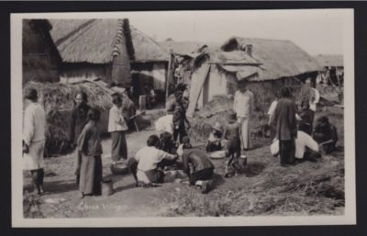
China in early 1900
The period 1900-1939 was dominated by two factors:
Japanese invasion.
Civil War = Nationalists vs. the Communists.

Slide 12
China in early 1900
Before 1911:
Humiliation = China was forced to concede territory and grant trade concession to Britain, France, Germany, Japan, Russia and the USA through the forced Open Door Policy.

Slide 13
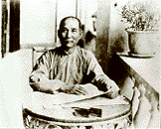
Dr. Sun Yat-Sen
Dr. Sun Yat-Sen led a mutiny of imperial troops, and the Emperor (of the Qing Dynasty) abdicated (1911).
Created the Kuomintang (KMT or Chinese Nationalist Party = The Nationalists) = a new governing body.

Slide 14
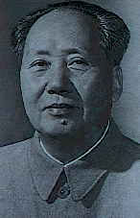
MAO
Mao Tse-tung was a Communist.
Allowed into the Kuomintang to help fight off the Manchu and the foreigners.
Worked to control countryside in China.

Slide 15
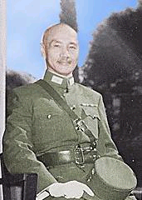
CHANIG
Chanig Kai-shek took over the Kuomintang as general in 1925 after Sun Yat-Sen`s death.
Controlled the South of China.

Slide 16
MAO + CHANIG
Led to the Long March of 1934:
Mao took his followers into the countryside to escape the Nationalists/The Kuomintang; they were attacked the entire way.

Slide 17
MAO + CHANIG
In Shensi, Mao would create a model Communist society to see if it would work.
The Chinese Civil War would be put on hold with the Japanese invasion of 1937, where Mao would do most of the resistance fighting.

Slide 18
The Rape of Nanking
The Nanking Massacre or Nanjing Massacre, also known as the Rape of Nanking, was a six-week period following the Japanese capture of the city of Nanjing (Nanking), the former capital of Republic of China, on December 13, 1937.

Slide 19
The Rape of Nanking
During this period, hundreds of thousands of civilians were murdered and raped by soldiers of the Japanese Army.

Slide 20
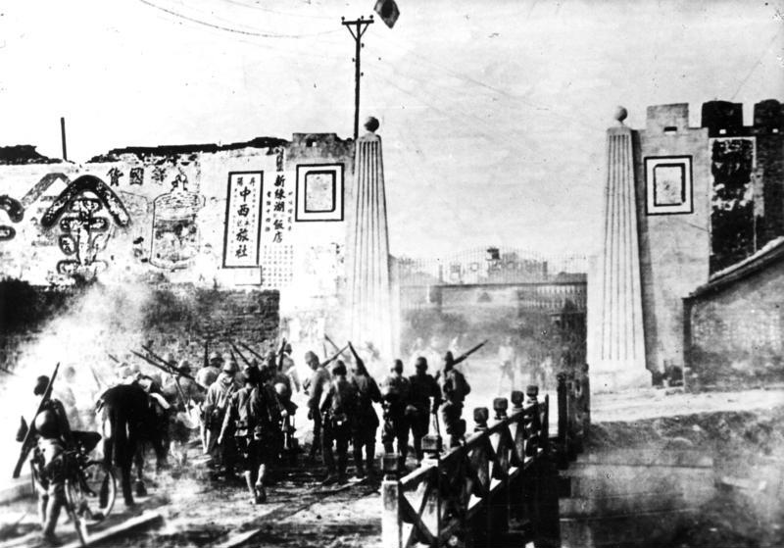

Slide 21
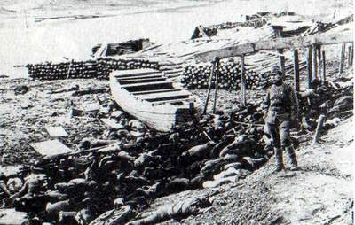

Slide 22
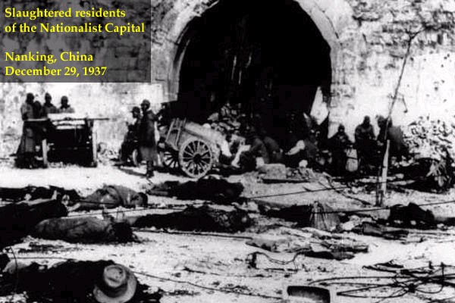
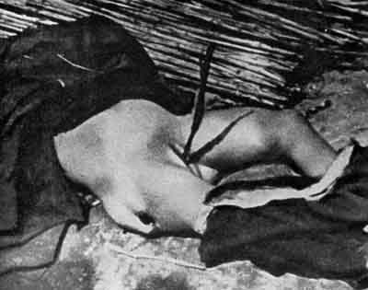

Slide 23
Comfort Women
Women from China, Korea, Philippines, Malaysia were taken prisoner / tricked / kidnapped and forced to become sex-slaves for the Japanese Imperial Army = Comfort Women / Comfort Stations.
http://www.youtube.com/watch?v=wcPfGwrzSYQ (WW2 Comfort Women, 4:51)

Slide 24
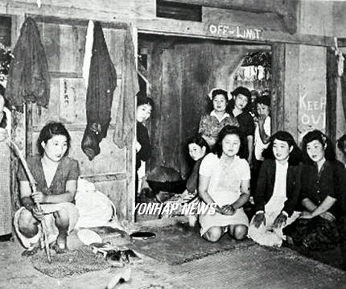
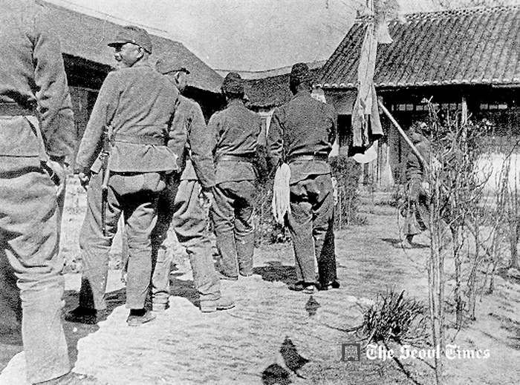

Slide 25
Aggressive nationalism + Militarism
The same forces – aggressive nationalism and militarism - would push her towards a war of conquest in Asia.
Japan was slowly taking over China = Chinese resistance was formidable.
The Chinese government received aid from the USA (supplies + money) justified via the Open Door Policy.

Slide 26
The “greater east Asian co-prosperity sphere”
The USA’s role in the war severely annoyed the Japanese.
July 1940, Japan announced the formation of the “Greater East Asian Co-Prosperity Sphere,” and invited the other countries of South-East Asia to join her.

Slide 27
The “greater east Asian co-prosperity sphere”
The Dutch East Indies (Indonesia) refused to join = no oil given to Japan.
In 1941, Vichy France (Pro-Nazi regime in France from 1940-44) granted Japan with special privileges in southern Indochina (present day Cambodia, Laos, Vietnam, Burma + Thailand).

Slide 28
USA’s reaction to Japan
The USA took two rather stern actions:
She froze Japanese assets in America on July 26, 1941.
On October 4, 1941 the USA cut off Japan’s oil supply.
Without oil Japan could not remain a major power.

Slide 29
The Pearl harbour plan
The commander-in-chief of the Japanese Imperial Navy, Admiral Yamamoto, drew up his plan to attack Pearl Harbour.
The American Navy in the Pacific had to be eliminated in order for Japan to carry out the rest of her plan for Empire in the Pacific.

Slide 30
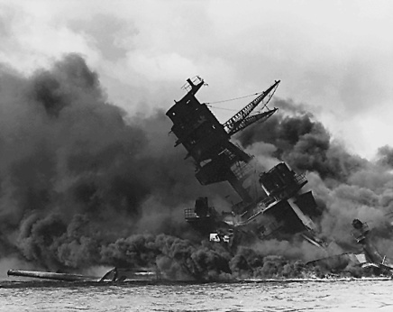
The USA enters the War
The surprise attack on Pearl Harbour, Hawaii on December 7th, 1941, had far reaching effects = it woke up a sleeping giant.
Roosevelt gave his famous “This is a Day of Infamy” speech, and the USA, as well as Britain, declared war on Japan.

Slide 31
The USA enters the War
Germany decided to help Japan by declaring war on the USA.
In this way the Grand Alliance that was going to fight the war for democracy was formed between the USA and Britain.

